Slide 2
CI/CD Pipeline with Jenkins
Course Introduction

Slide 3

Traditional Delivery Process
Any delivery process begins with the requirements defined by a customer and ends with the release to production. The diagram below shows the traditional delivery process:
Development
Quality
Assurance
Operations
Product
Owner
Analysis
Planning
Integration
Testing
Release
Implementation
Acceptance
Testing
Non-Functional
analysis
Monitoring
Unit testing
Demo
Release cycle
Notes:
Trainer Notes: Explain traditional delivery process

Slide 4

What Is Jenkins?
Build
Testing
Integration
Reporting
Deployment

Slide 5


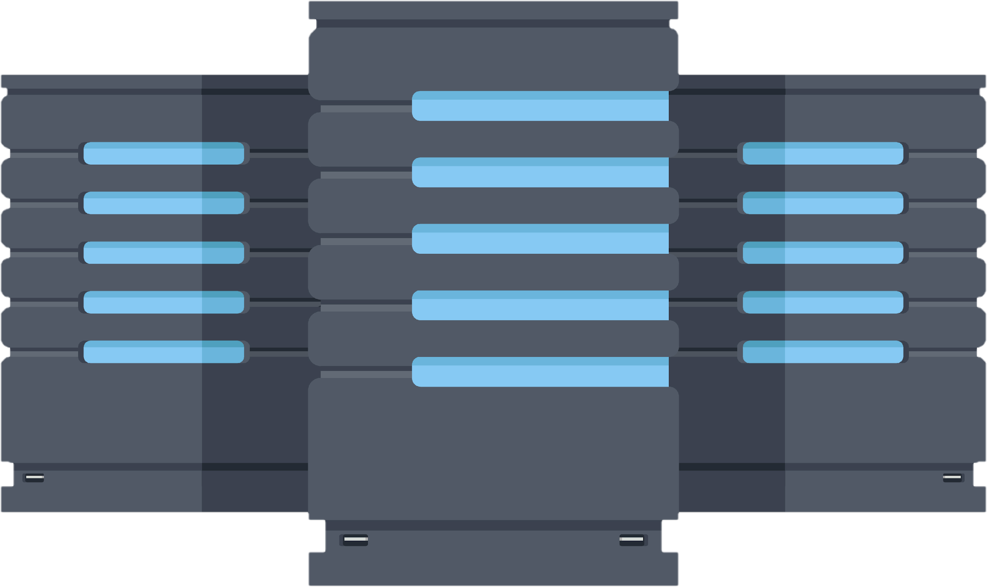




Features of Jenkins
Personalized Notification
Rapid Upgrades
Master/Slave Architecture
CI/CD Pipeline
Easy Installation
Increased Productivity

Slide 6
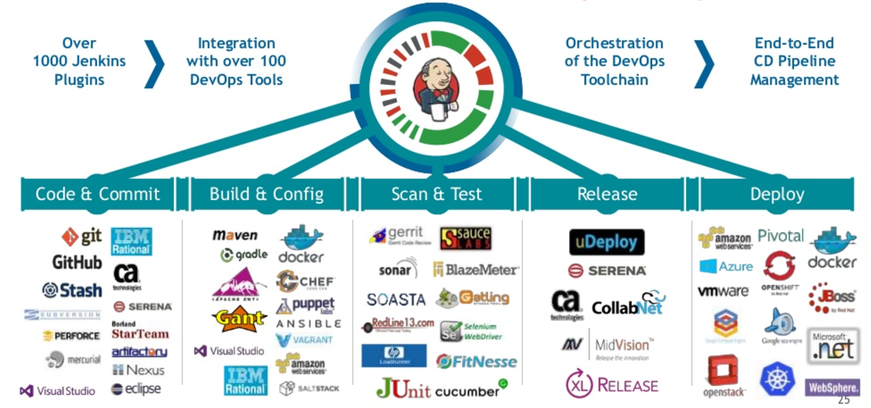
Jenkins as a CI/CD Tool

Slide 7
Where Is Jenkins Used?
Some of the industries that use Jenkins extensively for CI/CD pipeline development are given below:
Information Technology and Services
1
2
Hospital and Health Care
Financial Services
3
4
Insurance
Logistics
5

Slide 8
Course Outline
Introduction to CI/CD
1
A
2
Getting Started with Jenkins
One pre-read
Setting up Build Jobs
3
4
Configuring Build Pipelines
Automated Testing in Jenkins
5
6
Code Quality Improvement using Jenkins
Automated Deployment and Continuous Delivery
7
8
Distributed System in Jenkins

Slide 9
Course Outcome
Managing Jenkins plugins
Jenkins architecture
Jenkins integration
Concepts

Slide 10
Course Outcome
Jenkins jobs
Master/Slave architecture
Unit testing with Jenkins
Git and Maven
Jenkins pipeline
Concepts

Slide 11
Course Outcome
FindBugs
Jmeter
SonarQube
JaCoCo
Deployment with Tomcat
Workflow

Slide 12
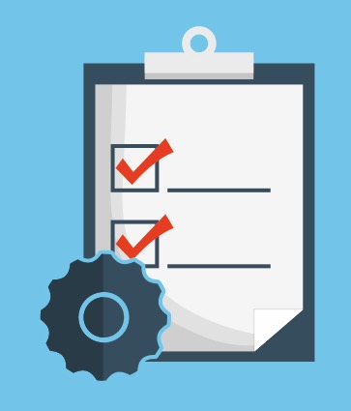





Course Components
Instructor-Led
Training
8 Lesson-End Projects
8 Knowledge Checks
2 Course-End
Assessments
40 Assisted and Unassisted Practices
2 Course-End Projects

Slide 13



Customer Support
Teaching assistant support
Help and support on the website
Call and live chat

Slide 14


Notes:
Lets begin

